Slide 1

Pitchfork Ratings SQL Exploration

Slide 2
Project Goal
Locate a suitable sqlite data set from Kaggle or Github
Map the DB structure
Plan and perform data exploration and share results
Where needed, bring in other platform tools to enrich analysis

Slide 3
Data Structure
Additional Data
reviews
reviewid
title
artist
url
score
best_new_music
author
author_type
pub_date
pub_weekday
pub_day
pub_month
pub_year
Primary Key
genres
reviewid
genre
Findings:
genres and content tables can be joined for further analysis
content is the full text content of the review article
artists and labels are redundant data available as part of scraping process, but not required for further analysis
content
reviewid
content
Redundant Data
artists
reviewid
artist
labels
reviewid
label
Data available at Kaggle Link: https://www.kaggle.com/datasets/nolanbconaway/pitchfork-data
Scrape process performed by user nolanbconway available at Github Link: https://github.com/nolanbconaway/pitchfork-data/tree/master

Slide 4





Basic Data Statistics
Findings:
3,906 NULL values for author_type will be investigated in a later slide
18,389 Total Reviews
18,393 without DISTINCT
8,633 Artists
432 Review Authors
Date Range: Jan 1999 - Jan 2017

Slide 5
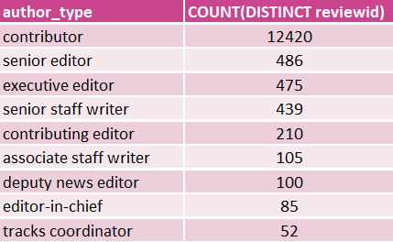
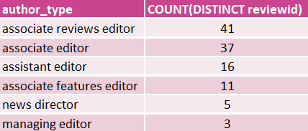

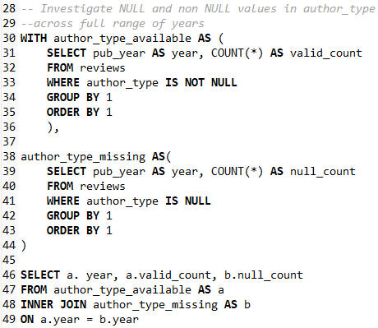
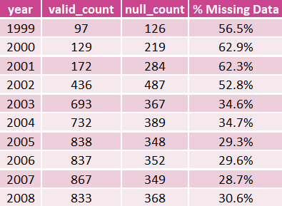
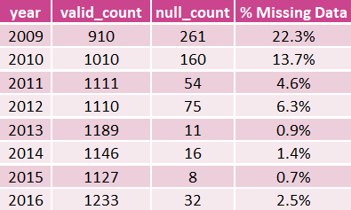
Author Types and Missing Data
Review counts by Author Type
NULL field investigation for Author Type
Findings:
NULL Values appear when an article does not present a contributor bio at the end of a web page. Data shows an increasing trend of regular contributors.

Slide 6
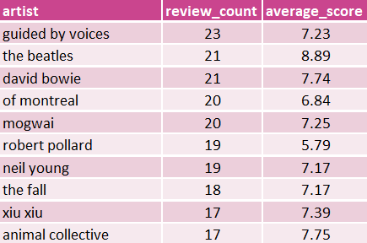
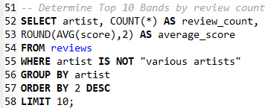
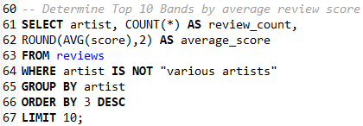
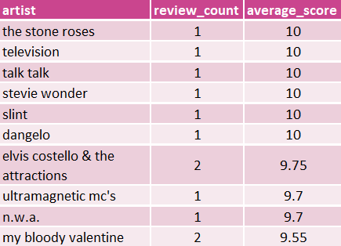
Top Artists Review Counts and Scores
Top 10 Bands by review count
Top 10 Bands by average score
Findings:
Top Scores are not related to overall attention from Pitchfork site to Artist overall

Slide 7
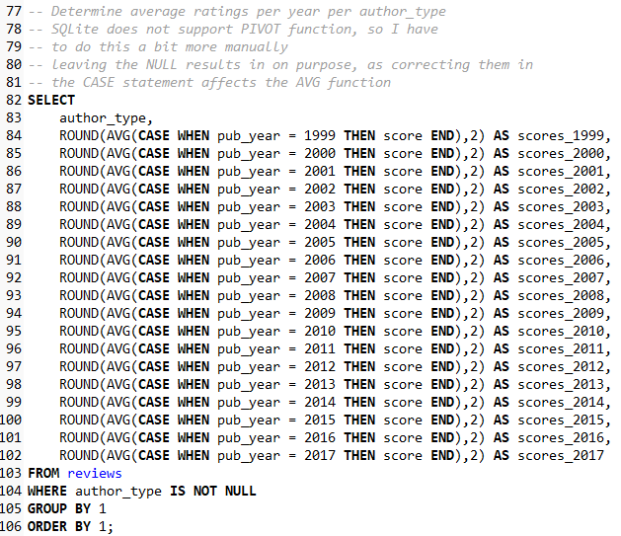
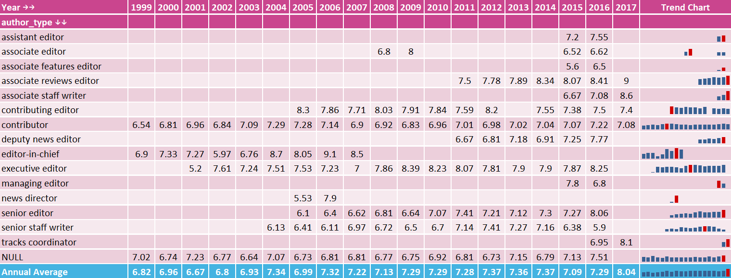
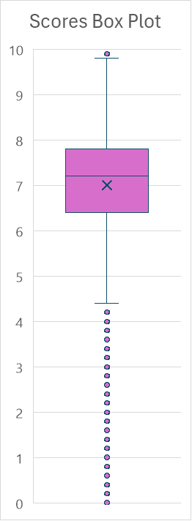
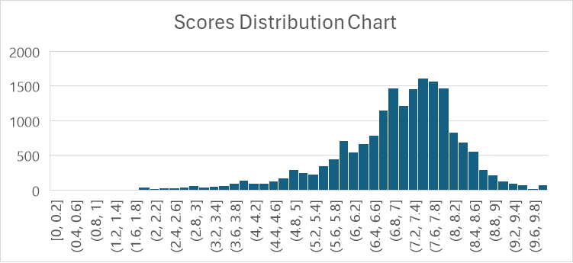
Author Type vs Scores
Average Score by year by author type
Findings:
IQR: From 6.4 to 7.8 / Mean: 7.2
Data Shape: Skewed left with lower score outliers
…
Score charts were also produced in Excel to confirm data shape and attributes

Slide 8
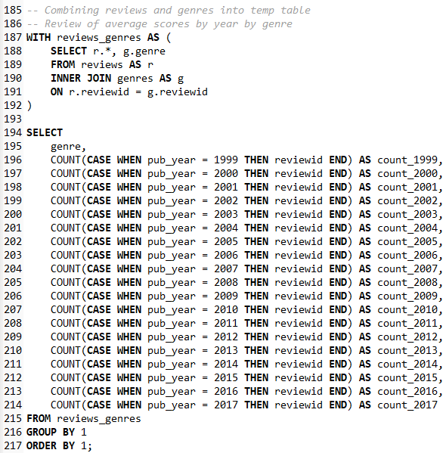
Genre vs Reviews
Genres Joined to Reviews Table, Averaged by
Findings:
At 41.6% of total reviews, the rock genre has clearly been prioritized on this site
electronic genre makes the second stable category
rap appears to be on a steady average rise within the dataset, with a peak in 2016

Slide 9
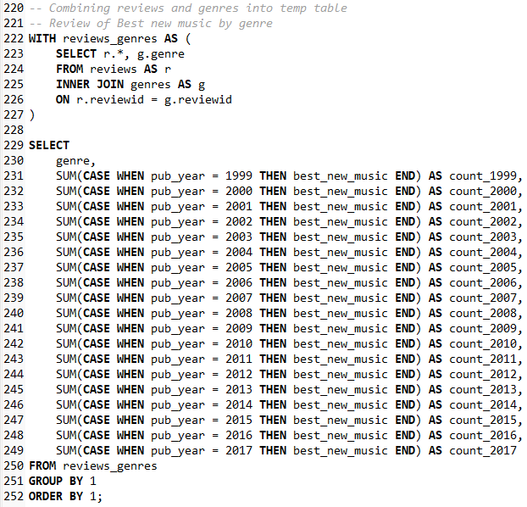
Genre vs Best New Music
Genres Joined to Reviews Table,
Count of Best New Music award
Findings:
At 46.8%, rock genre retains majority of Best New Music awards in parallel with majority of reviews, followed in similar trend by electronic genre
However, the rock genre is on a decline in 2015 and 2016 as electronic, rap and pop/r&b genres cover the gap
Best New Music award shows a doubling in frequency starting in 2009

Slide 10
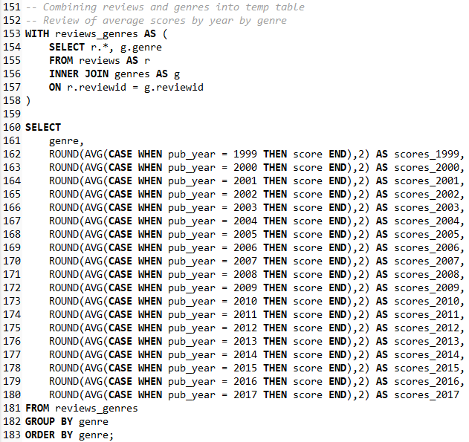
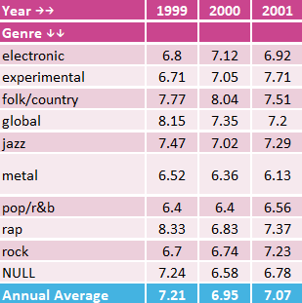
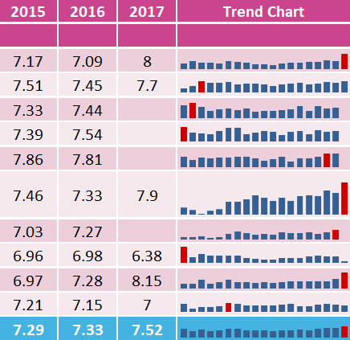
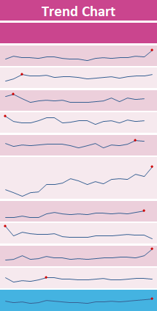
Genre vs Scores
Genres Joined to Reviews Table, Averaged score score by year
…
Findings:
Majority of genres show fairly stable average ratings
metal genre has shown a steady rise in ratings
electronic, metal and rock genres are experiencing peak average ratings in most recent year of data

